Slide 1

Multi-Data Center Tie-Line Power Smoothing Method Based on Demand Response
Authors: Ting Yang, Yuxing Hou, Shaotang Cai, Jie Yu, and Haibo Pen
Course Name: Cloud Computing
Course Code: CSE530
Semester: Spring 2024
Date: January 8, 2025

Slide 2
Presented By
Sabbir Mahmud Afridi | CSE-SH-2334
Nida Shahid | CSE-SK-2330
Presented To
Dr. Md. Abdur Razzaque
(Professor & Chairman)
Department of Computer Science and Engineering
University of Dhaka
1

Slide 3
Table of contents
Introduction
Problem Statement
Demand Response Model for Data Centers
Multi-Data Center Supply-Demand Model
Server Cluster Energy Consumption Model
Workload Model
UPS Battery Unit Model
Tie-Line Power Smoothing Method
Formulation of Demand Response Control Targets
Server Cluster Control Model
UPS Battery Control Model
Two-Stage Heuristic Power Regulation Algorithm
Workload Scheduling Algorithm
UPS Battery Unit Control Algorithm
Conclusion
2

Slide 4
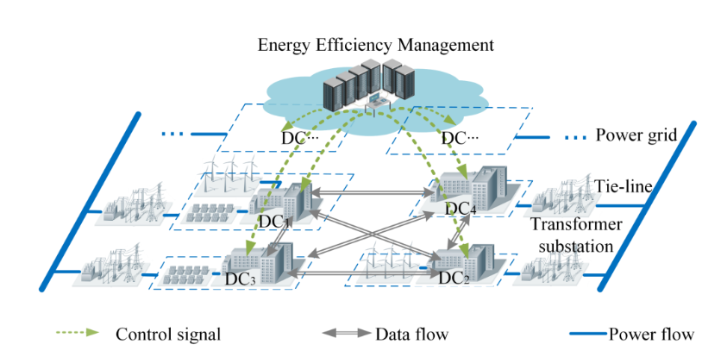
01
Introduction
Fig. Interconnected multi-data center system.
3

Slide 5
Problem statement
1. Energy Consumption in Data Centers (DCs)
The increasing demand for data storage and computing power has led to challenges in managing the energy consumption of these DCs.
2. Fluctuations in Renewable Energy Sources (RES)
The integration of renewable energy sources into DC power provisioning systems introduces fluctuations due to the intermittent nature of RES, such as wind and solar power. These fluctuations can destabilize the power grid and affect the operation of IT equipment.
3. Randomness of User Requests
The unpredictable nature of user requests further exacerbates the fluctuations in DC power consumption, making it challenging to maintain stable power supply and operation.
4. Need for Power Smoothing
There is a necessity to develop a method that can smooth the power fluctuations in interconnected multi-data centers to ensure the reliability of both the DCs and the power grid.
4

Slide 6
DEMAND RESPONSE MODEL FOR DATA CENTERS
5

Slide 7
a. Multi-Data Center Supply-Demand Model
Typical Architecture of Interconnected Multi-Data Center System
Unified System: Provides essential services like collaborative computing and disaster-tolerant backup.
Data Centers (DCs) Overview:
DC1: Connects to various Renewable Energy Sources (RES).
DC2: Utilizes wind power from abundant local resources.
DC3: Incorporates a local photovoltaic (PV) power generation unit.
DC4: Powered exclusively by the grid.
Power-Balancing Relationship
$$P_{d}^{TL}+P_{d}^{UPS}+P_{d}^{RE}=P_{d}^{clusters}+P_{d}^{UL}$$
6

Slide 8
b. Server Cluster Energy Consumption Model
The power load of a server is primarily determined by its CPU utilization, reflecting the processor’s workload intensity.
$$P_{d}^{server}=P_{d}^{idle}+{\text{α}}_{d}^{CPU}(P_{d}^{max⁡_clusters}−P_{d}^{idle})$$
$$P_{d}^{DC}=P_{d}^{clusters}+P_{d}^{UL}=PUE_{d}.P_{d}^{clusters}$$
$P_{d}^{DC}=PUE_{d}.M_{0}.$($P_{d}^{idle}+{\text{α}}_{d}^{CPU}(P_{d}^{max⁡_clusters}−P_{d}^{idle}))$
7

Slide 9
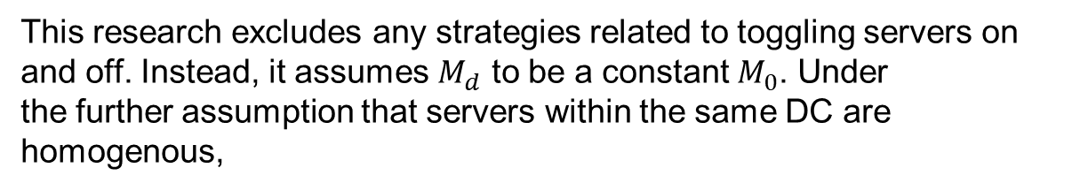
b. Server Cluster Energy Consumption Model (cont.)
This research excludes any strategies related to toggling servers on
and off. Instead, it assumes $M_{d}$ to be a constant $M_{0}$. Under
the further assumption that servers within the same DC are
homogenous,
$P_{d}^{DC}=PUE_{d}.M_{0}.$($P_{d}^{idle}+{\text{α}}_{d}^{CPU}(P_{d}^{max⁡_clusters}−P_{d}^{idle}))$
8

Slide 10
c. Workload Model
Characteristics of Data center Workload
Giant Power Load: Server clusters in DCs handle giant power loads due to high computational intensity. For example, Microsoft’s Quincy DC's peak load equals that of 40,000 households.
Time-Varying Load: Power demands fluctuate with user traffic, such as Facebook’s DC showing an 87% peak-to-valley difference over 30 minutes.
Complementary Load: Variability in user behavior and time zone differences across DCs allow complementary operational patterns, reducing overall power fluctuations.
9

Slide 11
c. Workload Model (cont.)
Task Classification
Delay-Sensitive Tasks:
$$T_{k}^{deadline}=T_{d,k}^{arrival}+t_{proc,k}$$
$$\text{Delay}\text{−}\text{Tolarant} \text{Tasks}\text{: }$$
$${[T}_{d,k}^{arrival},T_{d,k}^{arrival}+\text{Δ} T_{k}^{max⁡_dly}]$$
10

Slide 12
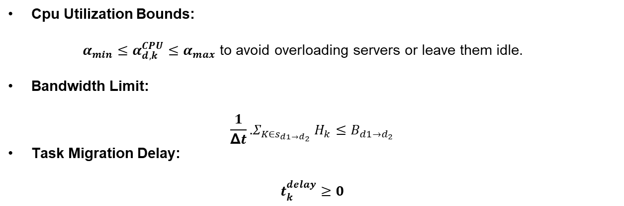
c. Workload Model (cont.)
Key Constraints
Cpu Utilization Bounds:
$α_{min}≤α_{d,k}^{CPU}≤α_{max}$ to avoid overloading servers or leave them idle.
Bandwidth Limit:
$$\frac{1}{\text{Δ}t}\text{.}Σ_{K∈s_{d1→d_{2}}} H_{k}≤B_{d1→d_{2}}$$
Task Migration Delay:
$$t_{k}^{delay}≥0$$
11

Slide 13
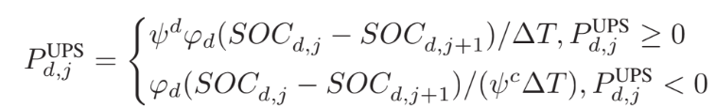

d. UPS Battery Unit Model
Key Constraints
12

Slide 14
TIE-LINE POWER SMOOTHING METHOD
13

Slide 15
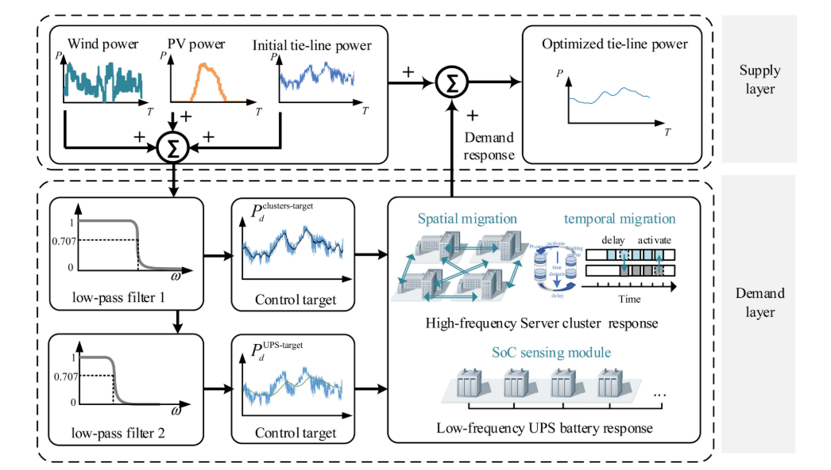
a. Formulation of Demand Response Control Targets
Tie-line power smoothing method based on two-layer filters.
14

Slide 16
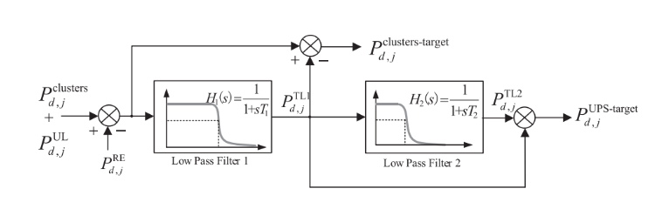
a. Formulation of Demand Response Control Targets (cont.)
Generation of server cluster and UPS battery control signals.
15

Slide 17
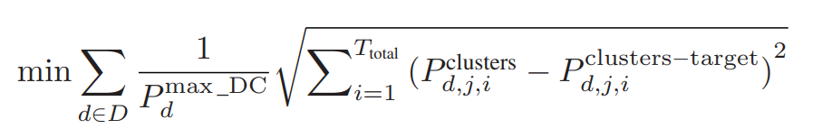
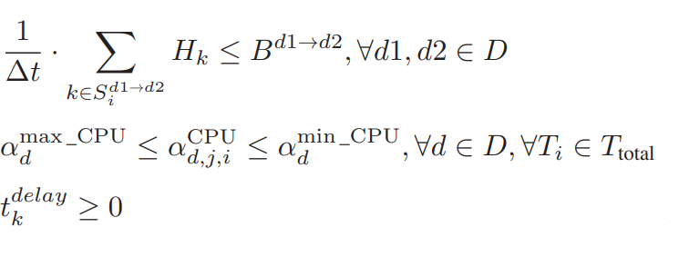
b. Server Cluster Control Model
Bandwidth Limitation:
CPU Utilization:
SLA adherence:
16

Slide 18
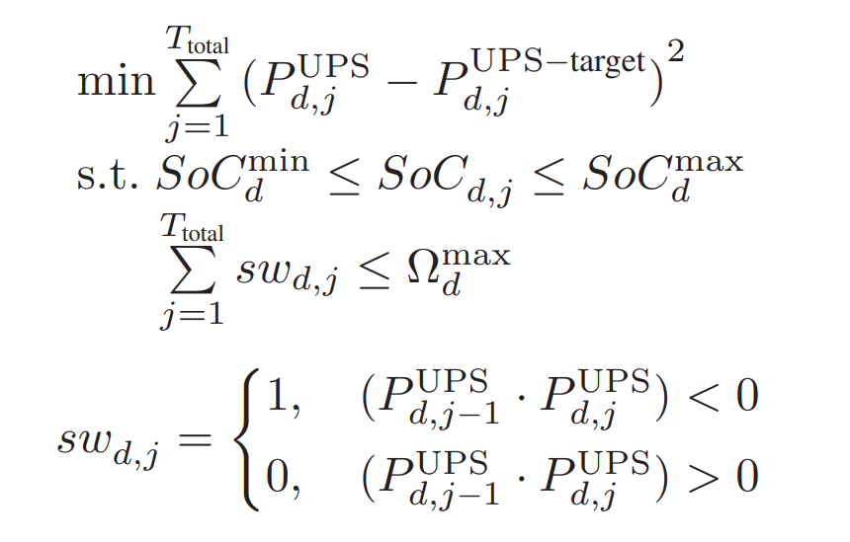
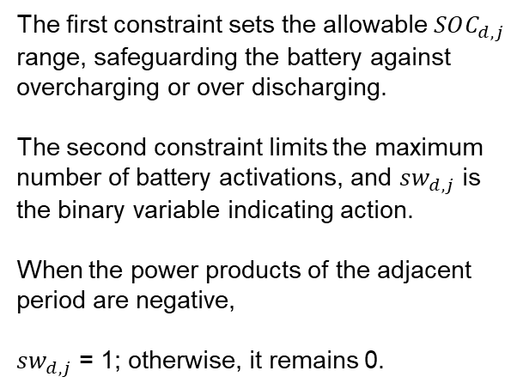
c. UPS Battery Control Model
The first constraint sets the allowable $SOC_{d,j}$ range, safeguarding the battery against overcharging or over discharging.
The second constraint limits the maximum number of battery activations, and $sw_{d,j}$ is the binary variable indicating action.
When the power products of the adjacent period are negative,
$sw_{d,j}$ = 1; otherwise, it remains 0.
17

Slide 19
TWO-STAGE HEURISTIC POWER REGULATION ALGORITHM
18

Slide 20
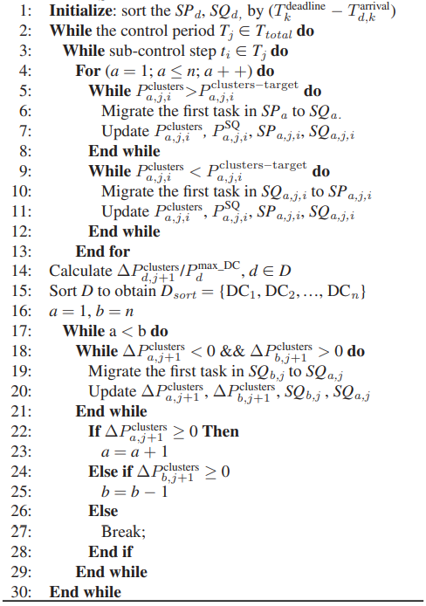
a. Workload Scheduling Algorithm
Purpose:
Align server power consumption with targets using intra- and inter-data center task migration.
Smooth out high-frequency fluctuations due to workload variations.
19

Slide 21
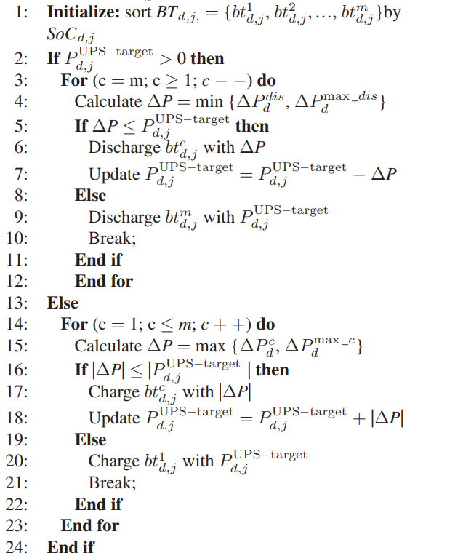
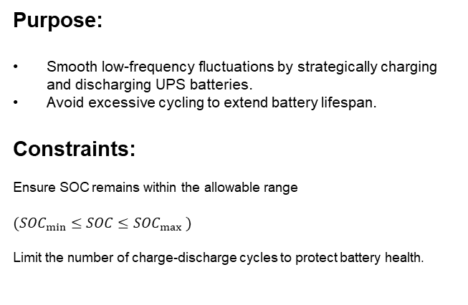
b. UPS Battery Unit Control Algorithm
Purpose:
Smooth low-frequency fluctuations by strategically charging and discharging UPS batteries.
Avoid excessive cycling to extend battery lifespan.
Constraints:
Ensure SOC remains within the allowable range
$$(SOC_{min}≤SOC≤SOC_{max} )$$
Limit the number of charge-discharge cycles to protect battery health.
20

Slide 22
Key Results
Fluctuation Mitigation:
Peak-to-valley differences reduced by up to 55.49%.
Power standard deviation decreased significantly.
UPS Efficiency:
Reduced charging/discharging cycles by 92.34%.
Increased state-of-charge (SOC) variation by 25.44%, enhancing battery utilization.
21

Slide 23
Future Work
Incorporate advanced optimization algorithms to improve scheduling and battery management.
Explore real-world deployments in dynamic, interconnected data centers.
Enhance compatibility with emerging renewable energy technologies.
22

Slide 24
CONCLUSION

